Slide 1

Project Title – Analyzing Car Dekho used-car data using data analysis and data visualization
Students Name- Vaibhavi Shukla
Students ID-
STU690cb34e4f5eb1762440014

Slide 2

PROBLEM STATEMENT
1. The used-car market contains vehicles with different prices, fuel types, transmission types, and usage levels.
2. It is difficult to understand which factors have the greatest impact on a car’s selling price.
3. Buyers and sellers need data-driven insights to evaluate a vehicle’s fair market value.
4. This project analyzes historical Car Dekho data to identify important market trends and pricing patterns.
5. The goal is to provide meaningful insights that can support better buying, selling, and pricing decisions.

Slide 3
Project Description This project focuses on analyzing Car Dekho used-car data using data analysis and visualization techniques. The dataset contains information such as car name, manufacturing year, selling price, present price, kilometers driven, fuel type, seller type, transmission, and number of previous owners. The analysis explores relationships between these variables and identifies the major factors influencing used-car prices. The project can help stakeholders understand market trends and make informed decisions. End Users • Car Buyers – to compare cars and identify reasonable prices. • Car Sellers – to estimate competitive selling prices. • Car Dealers – to understand demand and pricing trends. • Used-Car Businesses – to support inventory and pricing decisions. • Data Analysts/Business Teams – to derive insights from automobile market data.

Slide 4

WHO ARE THE END USERS?
The primary end users of the Car Market Trends Analysis system are car buyers, used-car dealers, automobile companies, online automobile platforms, data analysts, and researchers. The analysis helps these users understand market trends, compare prices, identify popular car categories, and make data-driven decisions regarding buying, selling, and pricing of used cars.

Slide 5

Technology Used
Technology Used : Python , Pandas, Matplotlib, Seaborn and Num Py

Slide 6
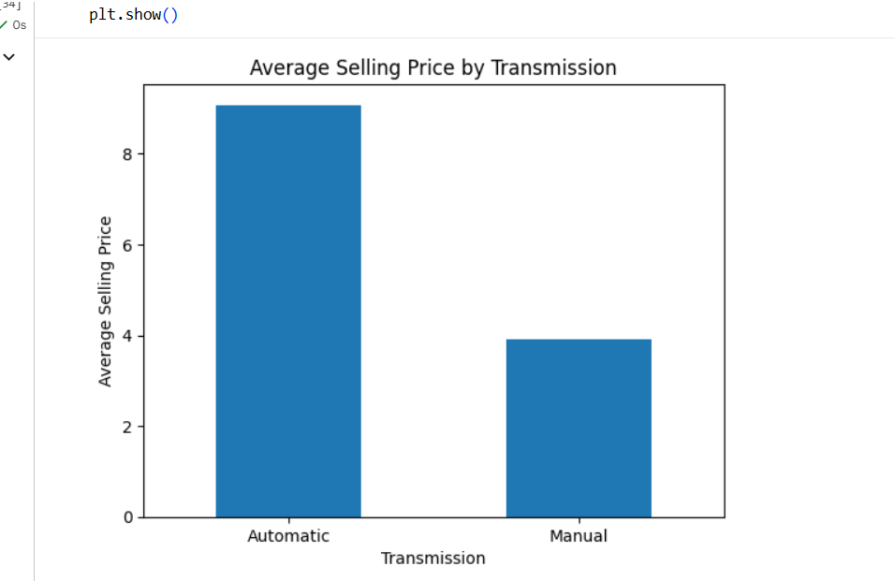
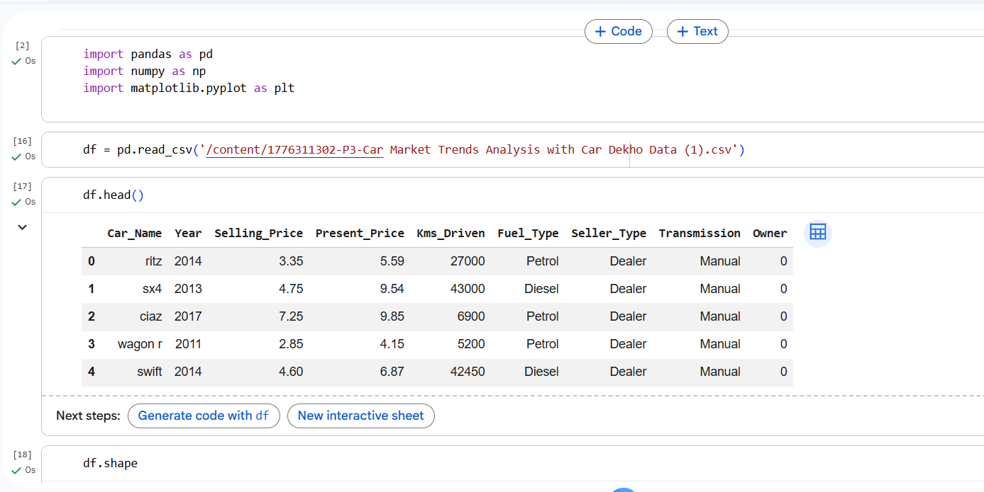
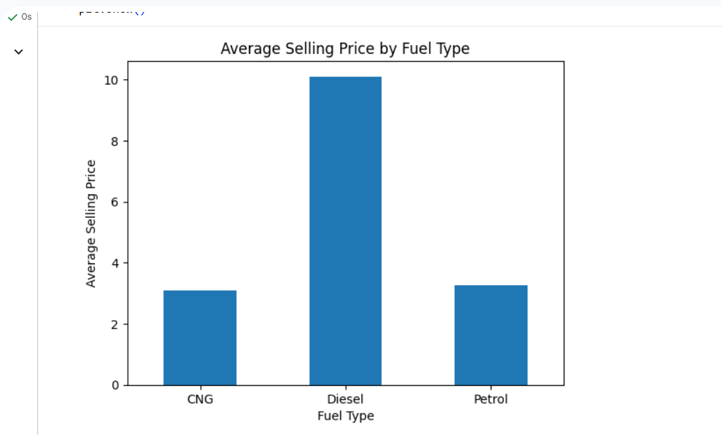
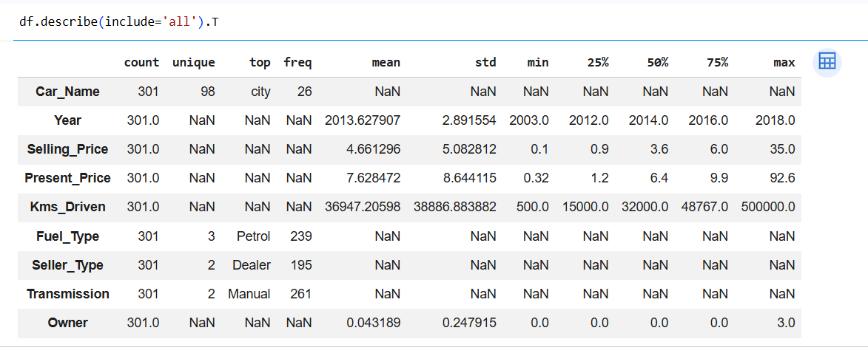
RESULTS
Demo Link-https://github.com/vaibhavishukla45-code/VOIS-.git

Slide 7
Thank you
.
.

